Slide 1

NOVA Tech
Software Plan

Slide 2
Welcome
Client: Dr. Erik Eddy
  CEO of TEAMS 101
Guest: Dr. Meg Fryling
Guest: Dr. Darren Lim

Slide 3
Agenda
Introduction
Problem Definition
System Justification
System Goals
System Constraints
Resources
Development Model
Timeline

Slide 4
Introduction
Emma Bostian – Team Lead
Kevin Conner – Web Master
Dave Hall – Database Administrator
Sara Pinti – System Administrator
Justin Rose – Software Engineer

Slide 5
Agenda
Introduction
Problem Definition
System Justification
System Goals
System Constraints
Resources
Development Model
Timeline

Slide 6
Problem Definition
Client: Dr. Erik Eddy
Team Evaluation: Application on the TEAMS 101 Portal
  Currently no website for teammates to provide group evaluations
  Groups only provide feedback after project has terminated
Notes:
Dr. Eddy studies how teams interact and qualities that successful groups display. Typical group evaluations do not hit on the specific group behaviors that are vital to a team’s success. Dr. Eddy has an understanding of the qualities that successful groups have and believes that this software will allow teams to operate more cohesively and ultimately more productively. By giving teammate feedback halfway through the project, team members are granted the ability to alter the way they interact with their team, in order to produce a better end result.

Slide 7
System Justification
Allows teammates to alter work ethic/behavior throughout project
Better teammate evaluation grade
Professor is more aware of team dynamic
Easy to access, small time commitment
Notes:
Dr. Eddy would like the software to be stress free and easy to access. Teammate Evaluation will allow students convenient access to the site and will not be time consuming. It will allow students to produce anonymous evaluations, which will encourage honest answers. Teammate Evaluation will also allow the administrator a full view of their student’s progress, giving them a comprehensive view of the team dynamic. Ultimately this provides students with a better team experience, and gives them liberty to adjust their work ethic throughout the project in order to obtain a better participation grade.

Slide 8
Agenda
Introduction
Problem Definition
System Justification
System Goals
System Constraints
Resources
Development Model
Timeline

Slide 9
System Goals
Web based software
Easy student login
Dual-view administrator account
Work in tandem with Siena email
Update Blackboard
Notes:
To reiterate a few of the highlights of the software, Teammate Evaluation will be an easily accessible website. It will provide student the opportunity to utilize the evaluations without the constraint of obtaining a new username and password. The administrator will be able to toggle between administrator view, where they can alter the teams, view individual evaluations, etc. and student view where they can use the site as a student. Another goal of the software is to give administrators the ability to email the Team Evaluation link to their students, and have them access it through their email accounts. As the students complete the evaluations, participation grades will be generated and updated on Blackboard.

Slide 10
Agenda
Introduction
Problem Definition
System Justification
System Goals
System Constraints
Resources
Development Model
Timeline

Slide 11
System Constraints
Access to Blackboard
Student login
Accessibility on mobile device
Notes:
Dr. Eddy has high hopes for the software in terms of accessibility goals. However we have encountered some blocks regarding alternative software, such as Blackboard. We do not believe that we have access to update Blackboard with Team Evaluation grades. In order to remediate these constraints, we must meet with IT and discuss our jurisdiction with accessing Blackboard. Another constraint resides with the student login. Dr. Eddy wants the site to be easily accessible, where students do not have to create new user accounts. However, if the links to the Evaluation are distributed through a chain email, we need a way to denote which students are completing the evaluations. Thus, we will discuss an alternative method for keeping track of student progress. Lastly, students will be accessing this site from mobile devices, thus we need to design our software to account for this constraint.

Slide 12
Agenda
Introduction
Problem Definition
System Justification
System Goals
System Constraints
Resources
Development Model
Timeline

Slide 13
Resources
Software
  Chrome, Safari, Firefox, Internet Explorer, Eclipse
Servers
  Oracle SQL
Operating Systems
  Mac OS X, Windows
Client
  Dr. Erik Eddy
Notes:
Primarily our information is coming from Dr. Eddy. We will be testing our software on a multitude of different web browsers, to ensure consistency. We will also be testing on both a Mac and a Windows PC, as well as a mobile device. Oracle SQL will provide us the database we need to query our data.

Slide 14
Agenda
Introduction
Problem Definition
System Justification
System Goals
System Constraints
Resources
Development Model
Timeline

Slide 15
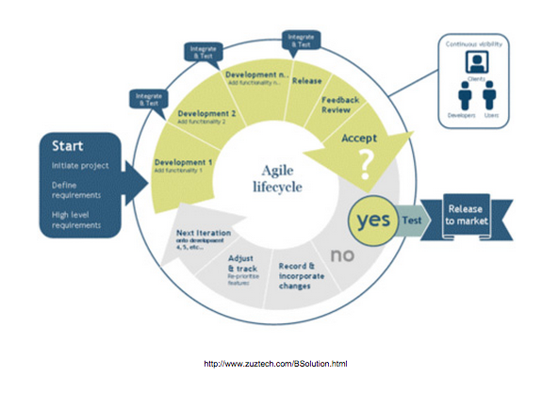
Agile Methodology
Notes:
We chose to use the agile method, because it gives us the liberty to develop on the prototype, test, and make amendments throughout the entire software project. The waterfall method did not allow us to test, fix bugs, and test again. The ability to alter our course of action gives us the freedom to make mistakes.

Slide 16
Agenda
Introduction
Problem Definition
System Justification
System Goals
System Constraints
Resources
Development Model
Timeline

Slide 17
Timeline: Fall Semester
Software Plan – September 19th
Team Website – September 30th
Data Dictionary – November 10th
Software Testing Strategies – November 13th
Design Documents – November 26th
Preliminary Design – December 2nd
Notes:
The fall semester is primarily planning. We have established weekly team meeting do divide up the work. We also have bi-weekly client meetings to ensure that our software will meet the requirements Dr. Eddy desires.

Slide 18
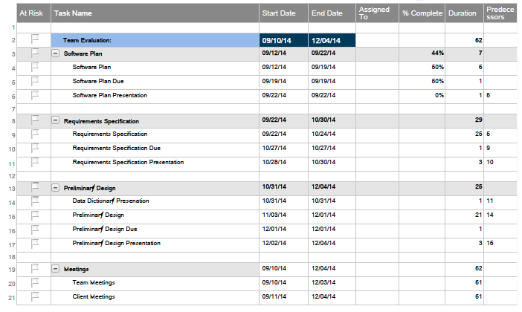
Timeline: Fall Semester
Notes:
The Gantt chart diagram displays the timeline for our project due dates. The overall software plan is broken down into specific components which will be completed at specific points in time throughout the fall semester. As the milestones are achieved, the Gantt chart will be updated.

Slide 19
Conclusion
Questions?

